Slide 1


MINI-PROJECT
CHESS.AI

Slide 2


01
TEAM
MEMBERS
MENTOR
KESHAV SHARMA
ASHUTOSH KR. SINGH
UJJWAL JAIN
AYUSH ANAND
ARVIND (3rd year)
SHASHWAT (3rd year)

Slide 3
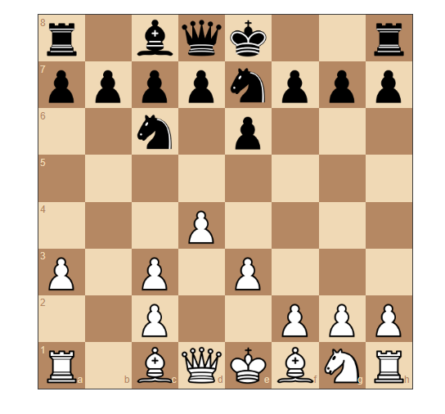

02
Introduction
Chess is a game that has fascinated human minds for centuries.Chess, often considered the "king of board games," is not just a game; it's a timeless battle of wits. Today, I'm excited to present our project on "Creating a Chess Game with AI Support."

Slide 4


03
Objetives
Our primary objective with this project is to explore how AI can enhance the experience of playing chess. Traditional chess games have limitations, especially for beginners or those seeking to improve their skills. AI can provide real-time guidance, helping players learn and become better strategists.

Slide 5
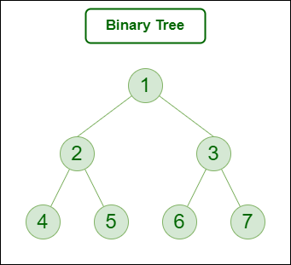
04
CREATION OF AI
MINI MAX ALGORTIHM
The minimax algorithm is a decision-making algorithm used in two-player turn-based games. It explores all possible moves in a game tree to find the best move for a player, assuming optimal play from both players. The algorithm alternates between maximizing and minimizing players and recursively evaluates each game state, assigning scores. The root node's best move is determined by propagating the best scores from the leaf nodes. The algorithm is commonly used in games like chess to determine the optimal move.

Slide 6
05
CREATION OF AI
ALPHA BETA PRUNING
Alpha-beta pruning is an optimization technique used in the minimax algorithm, primarily for decision-making in two-player turn-based games. It reduces the number of nodes evaluated in the search tree by eliminating branches that are guaranteed not to affect the final decision. The algorithm maintains two values, alpha and beta, representing the minimum score that the maximizing player is assured of and the maximum score that the minimizing player is assured of, respectively. When a node's evaluation falls outside the alpha-beta bounds, the search can be pruned, as further exploration of that branch is unnecessary. This optimization significantly reduces the time complexity of the search, making it more efficient for complex games like chess..

Slide 7


06
FRORNTEND
JAVASCRIPT
JavaScript is used within AngularJS controllers to control and manage different aspects of the game, such as updating the view (HTML) when the game state changes, handling user input, and managing game rules.
ANGULAR JS
Use AngularJS directives to bind UI elements like buttons, inputs, and the chessboard to your controllers.§Capture user input, such as selecting a piece and making a move, in your controllers. Use AngularJS event handling to respond to user actions.

Slide 8

07
FLASK
Flask is a lightweight and easy-to-use web framework for Python that is well-suited for building web applications and APIs .We used Flask application to handle chess moves, communicate with the chess engine, and update the board accordingly. We Implemented the necessary routes in Flask to handle moves, and update the board state accordingly.
@app.route('/move/<int:depth>/<path:fen>/')
def get_move(depth, fen):
engine = Engine(fen)
move = engine.iterative_deepening(depth - 1)
return move

Slide 9


08
Future Scope
Deploy it online
play it as a fantasy game
Storing the data of the use r

Slide 10


THANK YOU!

